Slide 1

CSA15 | Cloud Computing and Big Data Analytics
CSA15 Cloud Computing and Big Data Analytics
Presenter Details
Student Name: Vallapu Mohan Kumar
Register Number: 192524225
Class / Section / Slot: C
Capstone Title:FoodTrace Cloud Supply Chain Tracker with QR Provenance and Spoilage Prediction
Selected SDG Goal(s): SDG 2 (Zero Hunger)
Cloud Platform / Tools: Firebase, REST API, Python
Capstone Cloud Technical Presentation
Individual Student Presentation Deck
Presentation Focus
Present your capstone as a cloud-backed product. Explain the problem, architecture, service choices, evidence, and CO1 learning clearly.
Individual student submission template | Department of Computer Science and Engineering
CO1 AT3 | 01
Notes:
Open by naming the capstone problem and the cloud product objective. Keep the title slide uncluttered and clearly identify the individual presenter.

Slide 2
CSA15 | Cloud Computing and Big Data Analytics
Problem Context and Stakeholder Mapping
Our capstone begins with a real problem to solve
Problem Statement
Target Users
Lack of real-time food tracking causes spoilage, poor transparency, and reduced customer trust.
Farmers, distributors, retailers, customers, and administrators use Food Trace for secure product tracking and verification.
SDG Fit
Product Boundary
Supports SDG 2 – Zero Hunger by reducing food waste through cloud-based food traceability and spoilage prediction.
The first version includes user login, QR code scanning, cloud storage, spoilage prediction, and dashboard reporting.
Individual student submission template | Department of Computer Science and Engineering
CO1 AT3 | 02
Notes:
Do not start with technology. First make the need clear, then connect it to cloud-enabled scale, reach, or reliability.

Slide 3
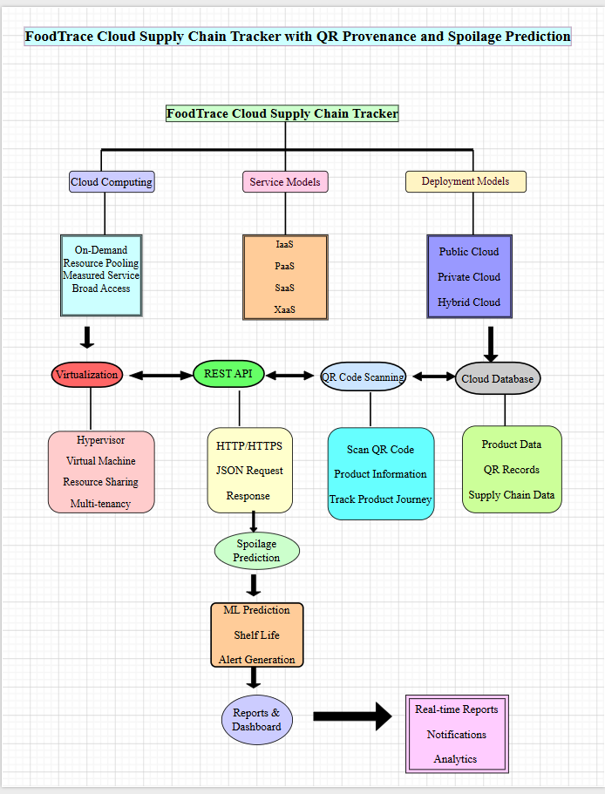
CSA15 | Cloud Computing and Big Data Analytics
Cloud Adoption Rationale and Concept Map
The problem needs cloud support to become a usable product
Cloud Definition
Cloud Concept Map
Cloud computing stores and manages food supply chain information online for secure, scalable, and real-time access.
Cloud Characteristics
On-Demand Access
Resource Pooling
Rapid Elasticity
Measured Service
Individual student submission template | Department of Computer Science and Engineering
CO1 AT3 | 03
Notes:
Students should explain the concept map as a reasoning artifact, not as decoration.

Slide 4
CSA15 | Cloud Computing and Big Data Analytics
Capstone Cloud Architecture
Our cloud architecture connects the user action to services
Scaling point
Food Trace Web/Mobile Application
REST API
Cloud Backend (Python)
• Firebase Firestore
• Cloud Storage
Security boundary
Presentation Points
Analytics + Monitoring
• Spoilage Prediction
• Firebase Analytics
Request path
API role
Compute choice
Database and storage
Monitoring and security
Scaling point
Individual student submission template | Department of Computer Science and Engineering
CO1 AT3 | 04
Notes:
Walk from user request to API, compute, data, storage, analytics, monitoring, and security boundary.

Slide 5
CSA15 | Cloud Computing and Big Data Analytics
Cloud Service Model Responsibility Matrix
Each service model defines what we control and what cloud manages
Service area
Model
Provider manages
Student team manages
Why this fits
SaaS
Application hosting
User interface
Easy web access
Frontend hosting
PaaS
Runtime & deployment
Business logic
Faster development
Backend/API
PaaS
Firebase Database
Product data
Real-time storage
Database
IaaS
Cloud storage
QR images & files
Secure storage
Storage
XaaS
Analytics service
Dashboard reports
System monitoring
Monitoring / logs
XaaS
Authentication
User roles
Secure login
Security / IAM
Individual student submission template | Department of Computer Science and Engineering
CO1 AT3 | 05
Notes:
Ask the student to defend provider responsibility and student responsibility for the selected service models.

Slide 6
CSA15 | Cloud Computing and Big Data Analytics
Data Flow and Analytics Pipeline
The product data moves from user activity to useful insight
Product information and supplier details.
Ingest
Firebase Cloud Database stores records.
Python predicts food spoilage.
Dashboard displays reports and alerts.
Collect
REST API transfers product data.
Store
Process
Visualize
Data Requirements
Analytics Requirement
Proof Required
Product details, QR codes, supplier information.
Spoilage prediction and dashboard reports.
Sample QR input, prediction output, dashboard.
Individual student submission template | Department of Computer Science and Engineering
CO1 AT3 | 06
Notes:
Big data analytics is optional, but a thoughtful data path is expected.

Slide 7
CSA15 | Cloud Computing and Big Data Analytics
Python / AI Module Integration
Python or AI adds intelligence where the product needs it
Python Role
Input and Output
Processes product data and predicts spoilage.
Input: Product information.
Output: Spoilage prediction.
Execution Point
Product Value
Runs in cloud backend through REST API.
Improves food safety and decision making.
Individual student submission template | Department of Computer Science and Engineering
CO1 AT3 | 07
Notes:
If AI is not required, students can present a Python automation or analytics module instead.

Slide 8
CSA15 | Cloud Computing and Big Data Analytics
Security, Scalability, Privacy and Cost Design
Security, scale, privacy and cost shape the final design
Security
Privacy
Firebase Authentication and encrypted cloud storage.
Only authorized users access product information.
Scalability
Cost Awareness
Cloud automatically supports increasing users.
Firebase free tier reduces deployment cost.
Individual student submission template | Department of Computer Science and Engineering
CO1 AT3 | 08
Notes:
This slide is where students show engineering judgment instead of simply listing services.

Slide 9
CSA15 | Cloud Computing and Big Data Analytics
Implementation Stack and Deployment Evidence
Our implementation stack shows how the design will be built
Mobile / Web Layer
Cloud Services
Flutter Web / Mobile Application
Firebase Authentication, Firestore, Storage, REST API
Evidence
Version Control
GitHub repository, Firebase Console, QR code screenshots
GitHub repository with commits and README
Individual student submission template | Department of Computer Science and Engineering
CO1 AT3 | 09
Notes:
Evidence should be specific and inspectable, not a generic list of tools.

Slide 10
CSA15 | Cloud Computing and Big Data Analytics
Demo Storyboard and User Journey
A complete user journey proves the product flow
Scene 1
Scene 2
Scene 3
User logs into FoodTrace.
Supplier uploads product information.
System generates a QR code.
Scene 4
Scene 5
Scene 6
Customer scans the QR code.
Cloud predicts product spoilage.
Dashboard displays reports and alerts.
Individual student submission template | Department of Computer Science and Engineering
CO1 AT3 | 10
Notes:
A storyboard helps the faculty see whether the cloud architecture is connected to actual use.

Slide 11
CSA15 | Cloud Computing and Big Data Analytics
Evaluation Readiness Checklist
Our evidence confirms that the presentation is ready
✅
Cloud ecosystem and service model explained
✅
Elasticity and scalability decisions are visible
✅
REST/SOAP/API role connected to capstone
✅
GitHub and cloud evidence are inspectable
✅
Architecture has compute, data, storage, security, monitoring
References and integrity statement are included
Evaluator Focus
CO1 is verified through cloud design reasoning, service choices, evidence, and individual explanation.
Individual student submission template | Department of Computer Science and Engineering
CO1 AT3 | 11
Notes:
Students can use this as the self-check slide before presenting the conclusion.

Slide 12
CSA15 | Cloud Computing and Big Data Analytics
Conclusion, Limitations and Future Scope
We close with learning, limitations and next steps
Learning Outcome
Limitations
Learned cloud computing, REST APIs, Firebase, and QR integration.
Requires internet connection and limited sensor integration.
Future Improvement
Integrity Statement
Add IoT sensors, blockchain, and advanced AI prediction.
Project developed for academic purposes using Firebase, Python, GitHub, and QR technologies.
Individual student submission template | Department of Computer Science and Engineering
CO1 AT3 | 12
Notes:
The ending should synthesize learning, not just say thank you.

